Slide 1

Statistical Learning Project
Filippo Santin Gurjeet Singh Francesca Zen

Slide 2

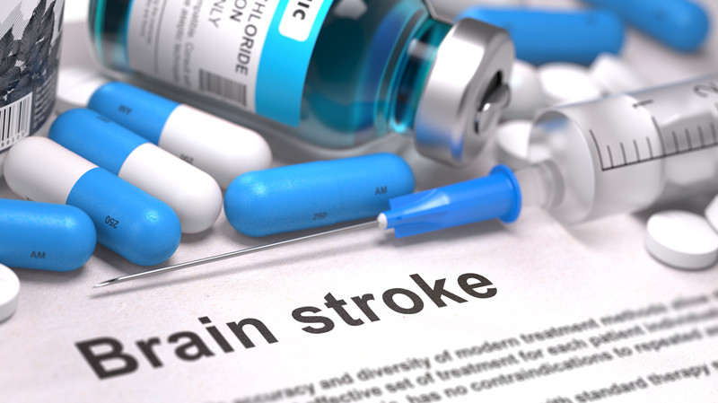
Data analysis on stroke detection
“Stroke” is the medical term for damage to brain tissue or the death of a portion of it, due to insufficient blood supply to an area of the brain
It is responsible for approximately 11% of total deaths
Normal values of glucose: 60-110 mg/dl
> 126 diabetes
Normal BMI range: 18.5 - 24.9
> 30.0 obesity

Slide 3
Dataset
id | gender | age | hypert. | hd | ev_ marr | work_ type | res_ type | glucose | bmi | smoking | stroke
9046 | Male | 67 | 0 | 1 | Yes | Private | Urban | 228.69 | 36.6 | formerly smoked | 1
51676 | Female | 61 | 0 | 0 | Yes | Self-employed | Rural | 202.21 | N/A | never smoked | 1
31112 | Male | 80 | 0 | 1 | Yes | Private | Rural | 105.92 | 32.5 | never smoked | 1
60182 | Female | 49 | 0 | 0 | Yes | Private | Urban | 171.23 | 34.4 | smokes | 1
1665 | Female | 79 | 1 | 0 | Yes | Self-employed | Rural | 174.12 | 24 | never smoked | 1

Slide 4
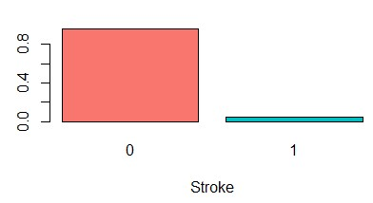
Dataset
Data variables: id, gender, age, hypertension, heart_disease, ever_married, work_type, Residence_type, avg_glucose_level, bmi, smoking_status, stroke
Missing values
Unbalanced data: 4,26% of the people get a stroke

Slide 5
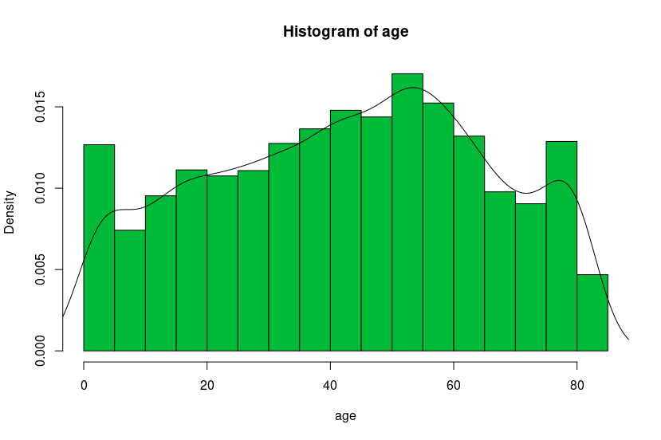
Age distribution
Data cover people of all ages from babies of 8 days to seniors of 82 years old

Slide 6
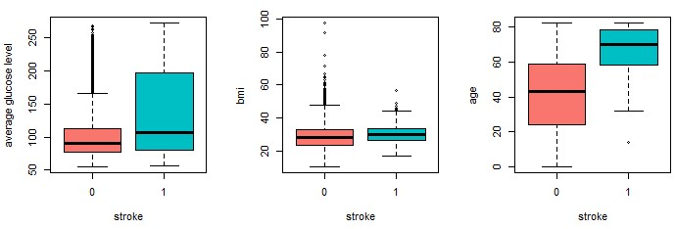
Explanatory Data Analysis (EDA)
High glucose level and bmi do not imply directly a stroke
Rare/interesting cases of stroke
Strong relation between age and stroke

Slide 7
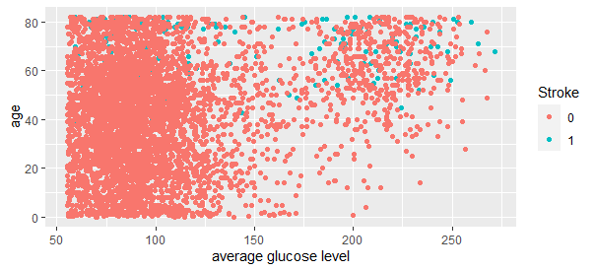
Not an easy problem
Non-linear separable
Not easy to identify a direct relationship with stroke diseases

Slide 8
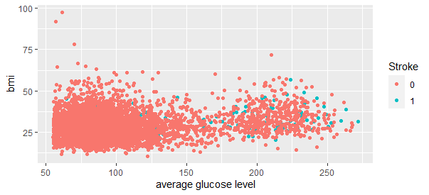
Not an easy problem
Glucose levels and Bmi could not be so strictly related to the disease but maybe correlated to other illnesses linked to it.

Slide 9
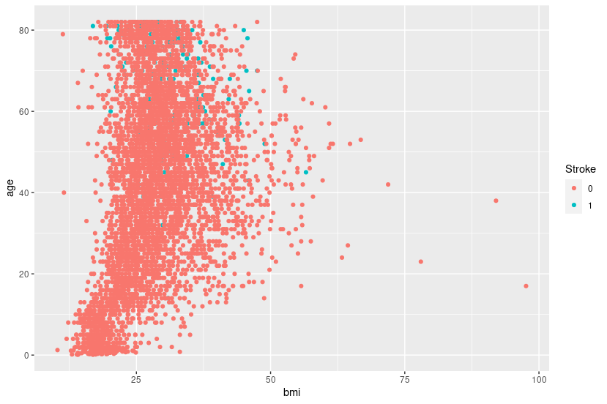
Not an easy problem
Strong correlation with age
Weak correlation with Bmi

Slide 10

Correlation between features
Presence of collinearity:
Age ~ Ever married : 0.68
Age ~ Work type : 0.54
Age ~ Smoking status : 0.39
Ever married ~ Bmi: 0.34
Correlated variables:
Stroke ~ Age: 0.23
Stroke ~ Hypertension: 0.14
Stroke ~ Avg. glucose level: 0.14

Slide 11

• Which factors are the most related to the stroke disease?
• How strong are the relations between the features?
• Are the given variables enough to predict a good accuracy of some possible person affected by stroke?
• Is it possible to prevent the stroke?
Relevant
Questions:

Slide 12

Tested Models
Logistic Regression
Full and Reduced Models
Interaction Models
Polynomial Models
Bayesian Models
LDA Model
QDA Model

Slide 13

LOGISTIC REGRESSION
A type of Generalized linear model (GLM)
The dependent variable is binary
1 STROKE
0 NO STROKE
Model selection:
Hypothesis
p-value
AIC

Slide 14
Reduced Model
Feature | Coef. | Level of significance
Age | 0.067547 | < 2e-16
Avg. Glucose level | 0.004802 | 0.000129
Heart disease | 0.404298 | 0.046895
Hypertension | 0.539613 | 0.001820
AIC: 1384.6

Slide 15
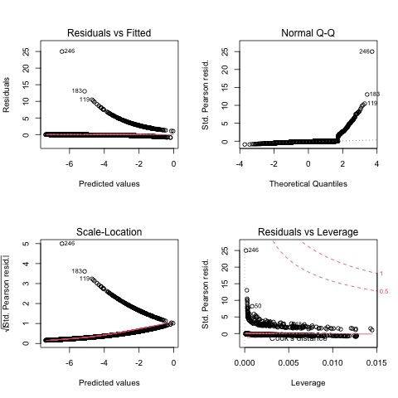
Reduced Model
Plots
Non-linearity in dataset
Residuals do not follow normal distribution
Heteroscedasticity
Leverage points
Outliers

Slide 16
"Outliers"
Able to infer some particular stroke cases, anomaly detection.
 | gender | age | hypert. | hd | ev_marr | work_type | res_type | glucose | bmi | smoking | stroke
119 | Female | 38 | 0 | 0 | No | Self-employed | Urban | 82.28 | 24.0 | formerly smoked | 1
183 | Female | 32 | 0 | 0 | Yes | Private | Rural | 76.13 | 29.9 | smokes | 1
246 | Female | 14 | 0 | 0 | No | children | Rural | 57.93 | 30.9 | Unknown | 1

Slide 17

Interaction between features
age ~ heart_disease, avg_glucose_level, bmi, hypertension
avg_glucose_level ~ heart_disease, bmi, hypertension
heart_disease ~ hypertension
bmi ~ hypertension

Slide 18
Best Interaction Model
Feature | Coef. | Level of significance
Age | 0.070133 | < 2e-16
Avg. Glucose level | 0.004702 | 0.000176
Heart disease | 2.765299 | 0.047694
Hypertension | 0.536550 | 0.001880
Age:heart disease | -0.032872 | 0.091604
AIC: 1384

Slide 19



Best Model Selection
To choose the best model among the electives ones we used Training and Validation testing method.
Data splits should be done carefully cause of unbalanced issue.
75% Training
25% Validation
Both splits have 4% of stroke cases
Training set Validation set

Slide 20

Best Model Selection
False Rates?
False negatives in medical cases
ROC or Precision-Recall curves?
Threshold

Slide 21
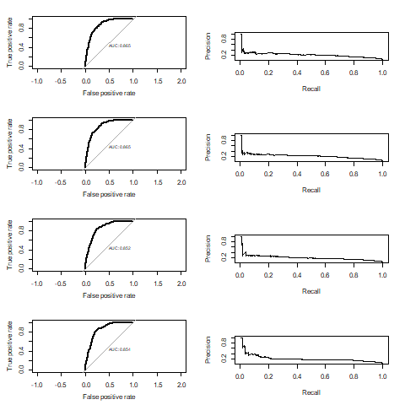
ROC
vs
Prec-Recall Curves

Slide 22
REDUCED MODEL
 |  | Predicted
 |  | 0 | 1
Ground thruth | 0 | 497 | 681
 | 1 | 1 | 48
INTERACTION MODEL
 |  | Predicted
 |  | 0 | 1
Ground thruth | 0 | 499 | 679
 | 1 | 1 | 48
Best
Model
Selection
LDA MODEL
 |  | Predicted
 |  | 0 | 1
Ground thruth | 0 | 490 | 688
 | 1 | 1 | 48
QDA MODEL
 |  | Predicted
 |  | 0 | 1
Ground thruth | 0 | 599 | 579
 | 1 | 4 | 45

Slide 23

Best Model Selection
- Error Rates -
REDUCED MODEL:
Positive rates: 0.0658
Negative rates: 0.0020
INTERACTION MODEL:
Positive rates: 0.0660
Negative rates: 0.0020
LDA MODEL:
Positive rates: 0.0652
Negative rates: 0.0020
QDA MODEL:
Positive rates: 0.0721
Negative rates: 0.0066

Slide 24

Conclusions
Interaction model is the best
Older people have higher probability to get a stroke​
Not easy to make ​secure predictions​
Increase the number of data​
Find more features related with stroke​
Find out the appropriate false rate​

